Slide 1
Computer Organization and Design More Arithmetic: Multiplication, Division & Floating-Point
Montek Singh
Apr 8, 2016
Lecture 12

Slide 2
Topics
Brief overview of:
integer multiplication
integer division
floating-point numbers and operations
Reading: Study Chapter 3.3-3.5

Slide 3
Binary Multipliers
The key trick of multiplication is memorizing a digit-to-digit table… Everything else is just adding
× | 0 | 1
0 | 0 | 0
1 | 0 | 1
× | 0 | 1 | 2 | 3 | 4 | 5 | 6 | 7 | 8 | 9
0 | 0 | 0 | 0 | 0 | 0 | 0 | 0 | 0 | 0 | 0
1 | 0 | 1 | 2 | 3 | 4 | 5 | 6 | 7 | 8 | 9
2 | 0 | 2 | 4 | 6 | 8 | 10 | 12 | 14 | 16 | 18
3 | 0 | 3 | 6 | 9 | 12 | 15 | 18 | 21 | 24 | 27
4 | 0 | 4 | 8 | 12 | 16 | 20 | 24 | 28 | 32 | 36
5 | 0 | 5 | 10 | 15 | 20 | 25 | 30 | 35 | 40 | 45
6 | 0 | 6 | 12 | 18 | 24 | 30 | 36 | 42 | 48 | 54
7 | 0 | 7 | 14 | 21 | 28 | 35 | 42 | 49 | 56 | 63
8 | 0 | 8 | 16 | 24 | 32 | 40 | 48 | 56 | 64 | 72
9 | 0 | 9 | 18 | 27 | 36 | 45 | 54 | 63 | 72 | 81
You’ve got to be kidding… It can’t be that easy!

Slide 4
Binary Multiplication
The “Binary” Multiplication Table
Binary multiplication is implemented using the same basic longhand algorithm that you learned in grade school.
X
0
1
Hey, that looks like an AND gate
0
0
0
A₃
A₂
A₁
A₀
1
0
1
x
B₃
B₂
B₁
B₀
A_{j}B_{i} is a “partial product”
A₃B₀
A₂B₀
A₁B₀
A₀B₀
A₃B₁
A₂B₁
A₁B₁
A₀B₁
A₃B₂
A₂B₂
A₁B₂
A₀B₂
+
A₃B₃
A₂B₃
A₁B₃
A₀B₃
Multiplying N-digit number by M-digit number gives (N+M)-digit result
Easy part: forming partial products (just an AND gate since B_{I} is either 0 or 1)
Hard part: adding M, N-bit partial products

Slide 5
Multiplication: Implementation
S
t
a
r
t
M
u
l
t
i
p
l
i
e
r
0
=
1
M
u
l
t
i
p
l
i
e
r
1
0
=
0
.
T
e
s
M
u
t
l
t
i
p
l
i
e
r
0
1
a
.
A
d
d
m
u
l
t
i
p
l
i
c
a
n
d
t
o
p
r
o
d
u
c
p
t
a
n
d
l
a
c
e
t
h
e
r
e
s
u
l
t
i
n
P
r
o
d
u
c
t
r
e
g
i
s
t
e
r
2
.
S
h
i
f
t
t
h
e
M
u
l
t
i
p
l
i
c
a
n
d
r
e
g
i
s
t
e
r
l
e
f
t
1
b
i
t
3
.
S
h
i
f
t
t
h
e
M
u
l
t
i
p
l
i
e
r
r
e
g
i
s
t
e
r
r
i
g
h
t
1
b
i
t
Hardware
Implementation
N
o
:
<
3
2
r
e
p
e
t
i
t
i
3
2
n
d
r
o
n
s
e
p
e
t
i
t
i
o
n
?
Flow Chart
Y
e
s
:
3
2
r
e
p
e
t
i
t
i
o
n
s
D
o
n
e

Slide 6
Second Version
S
t
a
r
t
M
u
l
t
i
p
l
i
c
a
n
d
3
2
b
i
t
s
M
u
l
t
i
p
l
i
e
r
0
=
1
M
u
l
t
i
p
l
i
e
r
1
0
=
0
.
T
e
s
t
M
u
l
t
i
p
l
i
e
r
M
u
0
l
t
i
p
l
i
e
3
2
r
-
b
i
t
A
L
U
S
h
i
f
t
r
i
g
h
t
3
2
b
i
t
s
S
h
i
f
t
r
i
g
h
t
1
a
.
A
d
d
m
u
l
t
i
p
l
i
c
a
n
d
t
o
t
h
e
l
e
f
t
h
a
l
f
o
P
f
r
o
d
u
c
t
C
o
n
t
r
o
l
t
e
s
W
t
r
i
t
e
t
h
e
p
r
o
d
u
c
t
a
n
d
p
l
a
c
e
t
h
e
r
e
s
u
l
t
i
n
t
h
e
l
e
f
t
h
a
l
f
o
f
t
h
e
P
r
o
d
u
c
t
r
e
g
i
s
t
e
6
4
b
r
i
t
s
2
.
S
h
i
f
t
t
h
e
P
r
o
d
u
c
t
r
e
g
i
s
t
e
r
r
i
g
h
t
1
b
i
t
3
.
S
h
i
f
t
t
h
e
M
u
l
t
i
p
l
i
e
r
r
e
g
i
s
t
e
r
r
i
g
h
t
1
b
i
t
More Efficient Hardware
Implementation
N
o
:
<
3
2
r
e
p
e
t
i
t
i
3
2
n
d
r
o
n
s
e
p
e
t
i
t
i
o
n
?
Flow Chart
Y
e
s
:
3
2
r
e
p
e
t
i
t
i
o
n
s
D
o
n
e

Slide 7
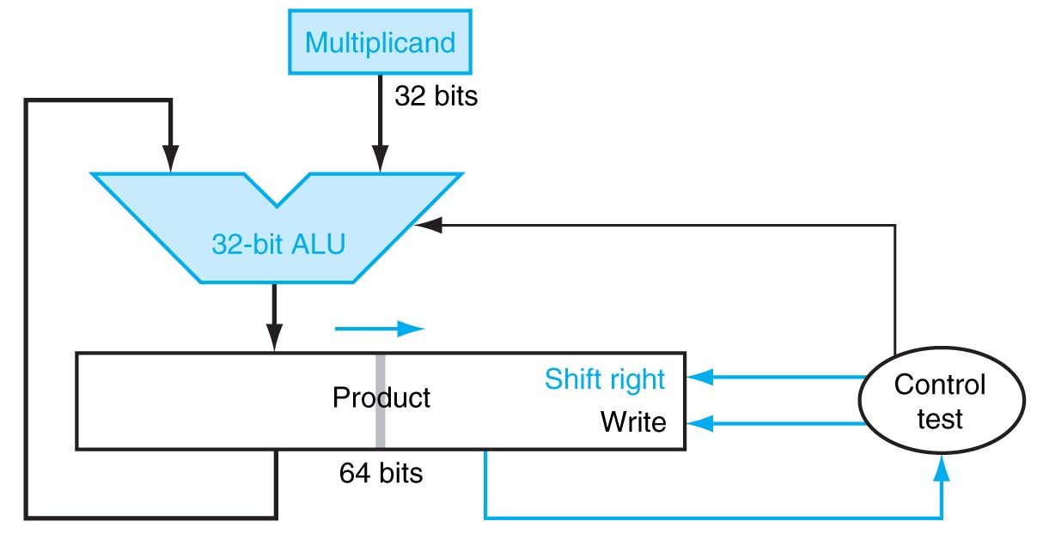
Final Version
S
t
a
r
t
P
r
o
d
u
c
t
0
=
1
P
r
o
d
u
c
t
1
0
=
0
.
T
e
s
t
P
r
o
d
u
c
t
0
1
a
.
A
d
d
m
u
l
t
i
p
l
i
c
a
n
d
t
o
t
h
e
l
e
f
t
h
a
l
f
o
f
t
h
e
p
r
o
d
u
c
t
a
n
d
p
l
a
c
e
t
h
e
r
e
s
u
l
t
i
n
t
h
e
l
e
f
t
h
a
l
f
o
f
t
h
e
P
r
o
d
u
c
t
r
e
g
i
s
t
e
r
2
.
S
h
i
f
t
t
h
e
P
r
o
d
u
c
t
r
e
g
i
s
t
e
r
r
i
g
h
t
1
b
i
t
The trick is to use the lower half of the product to hold the multiplier during the operation.
N
o
:
<
3
2
r
e
p
e
t
i
t
i
3
2
n
d
r
o
n
s
e
p
e
t
i
t
i
o
n
?
Y
e
s
:
3
2
r
e
p
e
t
i
t
i
o
n
s
D
o
Even More Efficient
Hardware Implementation!
n
e

Slide 8
Example for second version
Iteration
Step
Multiplier
Multiplicand
Product
0
Initial
1011
0010
0000 0000
1
Test true shift right
1011 0101
0010
0010 0000 0001 0000
2
Test true shift right
0101 0010
0010
0011 0000 0001 1000
3
Test false shift right
0010 0001
0010
0001 1000 0000 1100
4
Test true shift right
0001 0000
0010
0010 1100 0001 0110

Slide 9
What about the sign?
Positive numbers are easy
How about negative numbers?
Please read signed multiplication in textbook (Ch 3.3)

Slide 10
Can do we faster?
Instead of iterating in time…
How about iterating in space…?
repeat circuits in space
consume more area
but faster computation

Slide 11
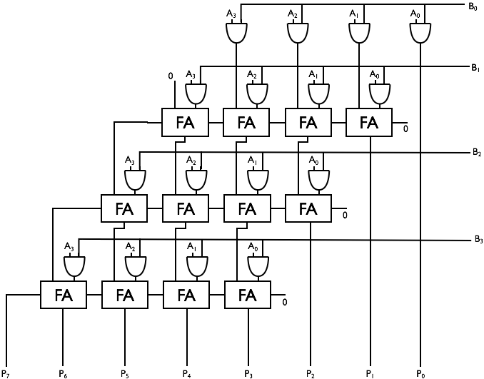
Simple Combinational Multiplier
“Array Multiplier”
repetition in space, instead of time
Components used:
N*(N-1) full adders
N² AND gates

Slide 12
Simple Combinational Multiplier
Propagation delay
Proportional to N
N is #bits in each operand
~ 3N*t_{pd,FA}

Slide 13
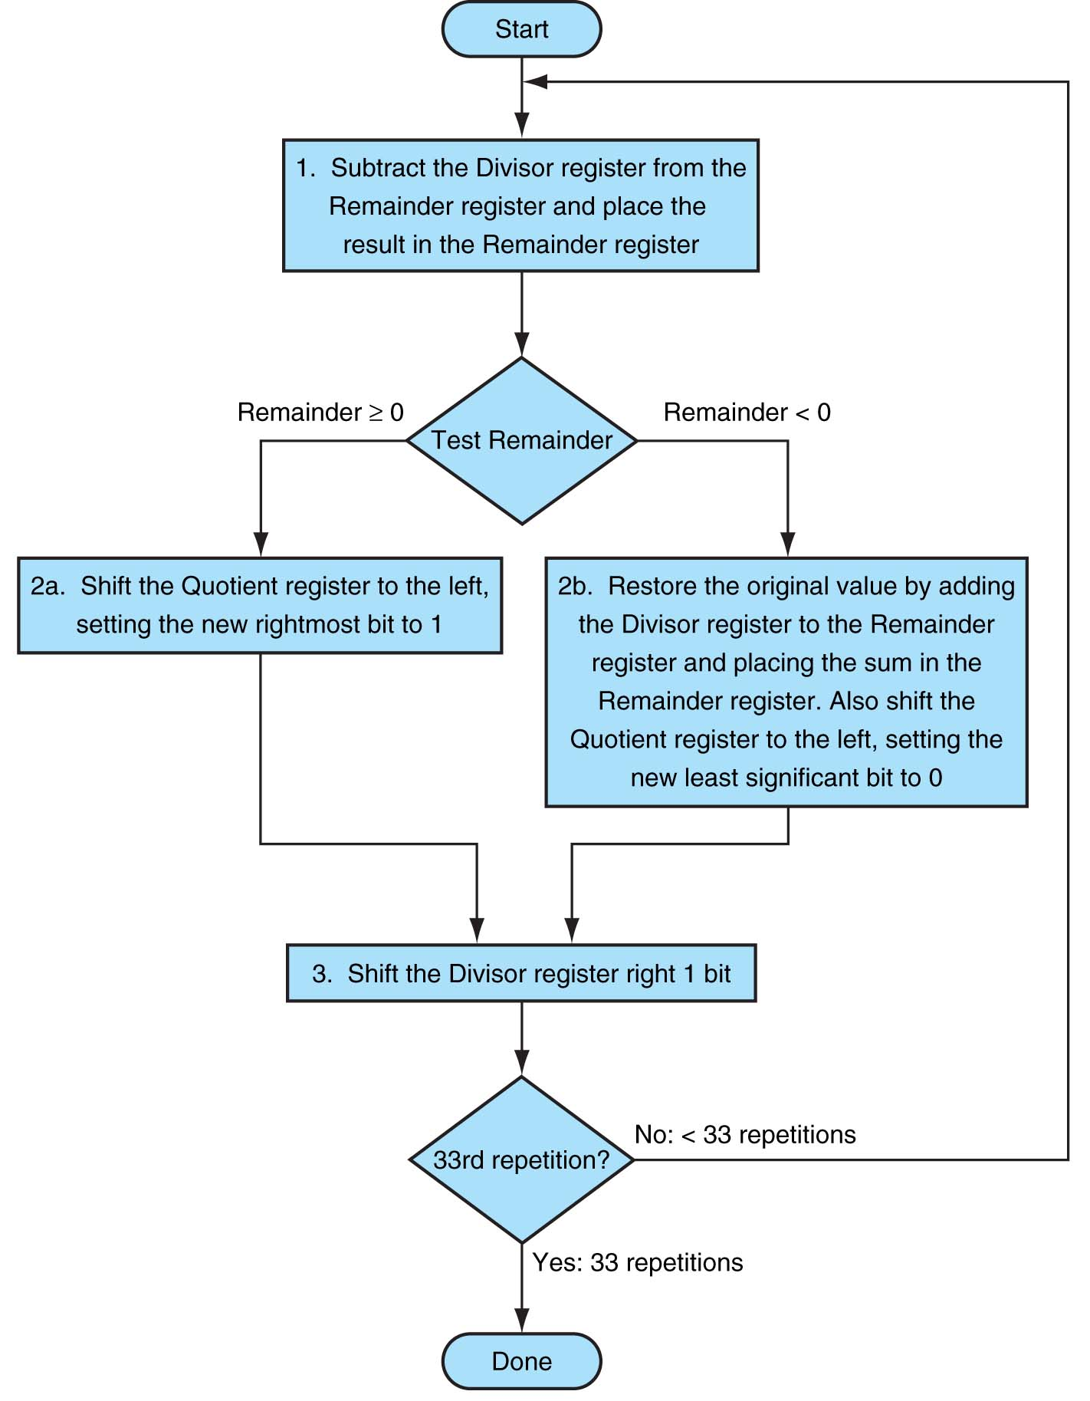
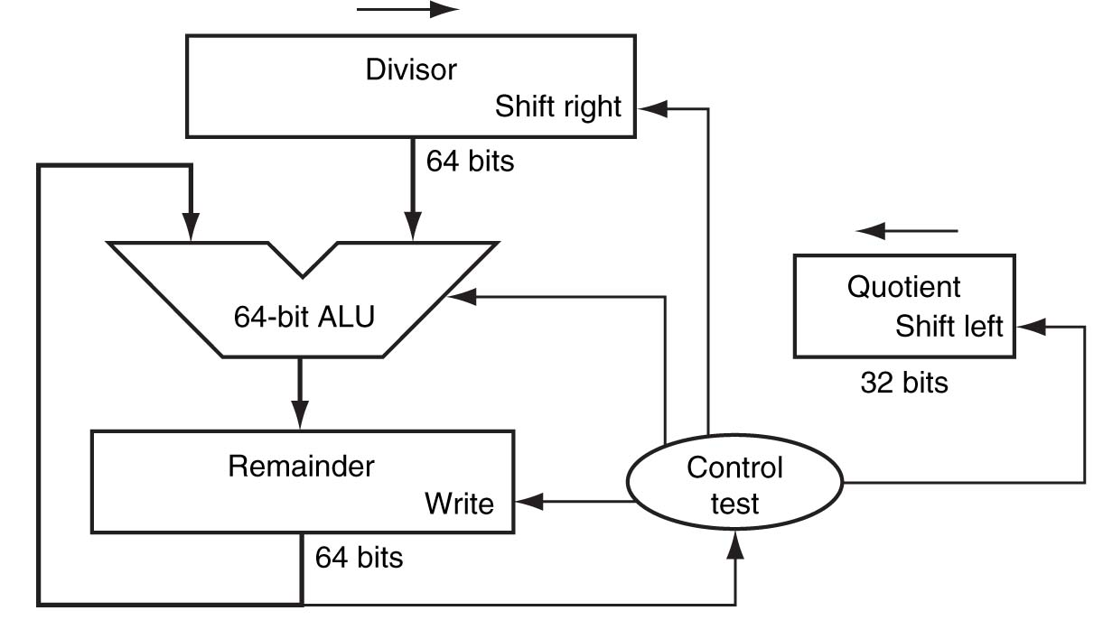
Division
Hardware
Implementation
See example in textbook (Fig 3.10)
Flow Chart

Slide 14
Floating-Point Numbers & Arithmetic
Reading: Study Chapter 3.5

Slide 15
Why do we need floating point?
Several reasons:
Many numeric applications need numbers over a huge range
e.g., nanoseconds to centuries
Most scientific applications require real numbers (e.g. π)
But so far we only have integers. What do we do?
We could implement the fractions explicitly
e.g.: ½, 1023/102934
We could use bigger integers
e.g.: 64-bit integers
Floating-point representation is often better
has some drawbacks too!

Slide 16
Recall Scientific Notation
Recall scientific notation from high school
Numbers represented in parts:
42 = 4.200 x 10¹
1024 = 1.024 x 10³
-0.0625 = -6.250 x 10⁻²
Arithmetic is done in pieces
1024 1.024 x 10³
- 42 -0.042 x 10³
= 982 0.982 x 10³
= 9.820 x 10²
Significant Digits
Exponent
Before adding, we must match the exponents, effectively “denormalizing” the smaller magnitude number
We then “normalize” the final result so there is one digit to the left of the decimal point and adjust the exponent accordingly.

Slide 17
Multiplication in Scientific Notation
Is straightforward:
Multiply together the significant parts
Add the exponents
Normalize if required
Examples:
1024 1.024 x 10³
x 0.0625 6.250 x 10⁻²
= 64 6.400 x 10¹
42 4.200 x 10¹
x 0.0625 6.250 x 10⁻²
= 2.625 26.250 x 10⁻¹
= 2.625 x 10⁰ (Normalized)
In multiplication, how far is the most you will ever normalize?
In addition?

Slide 18
Binary Floating-Point Notation
IEEE single precision floating-point format
Example: (0x42280000 in hexadecimal)
Three fields:
Sign bit (S)
Exponent (E): Unsigned “Bias 127” 8-bit integer
E = Exponent + 127
Exponent = 10000100 (132) – 127 = 5
Significand (F): Unsigned fixed-point with “hidden 1”
Significand = “1”+ 0.01010000000000000000000 = 1.3125
Final value: N = -1^{S} (1+F) x 2^{E-127} = -1⁰(1.3125) x 2⁵ = 42
0
1 | 0 | 0 | 0 | 0 | 1 | 0 | 0
0 | 1 | 0 | 1 | 0 | 0 | 0 | 0 | 0 | 0 | 0 | 0 | 0 | 0 | 0 | 0 | 0 | 0 | 0 | 0 | 0 | 0 | 0
“S”
Sign Bit
“E”
Exponent + 127
“F” Significand (Mantissa) - 1
Notes:
In floating point, two’s complement does not work because things aren’t aligned correctly. This is because of the exponents…
You need a leftmost sign bit which indicates either negative or positive, if it is 0 it is positive
The green E is the expononent, the exponent also allows negatives using a bias. All numbers get 127 added to it, so if you want 0 you make it 127
Significand is a decimal with an added assumed 1

Slide 19
Example Numbers
One
Sign = +, Exponent = 0, Significand = 1.0
1 = -1⁰ (1.0) x 2⁰
S = 0, E = 0 + 127, F = 1.0 – ‘1’
0 01111111 00000000000000000000000 = 0x3f800000
One-half
Sign = +, Exponent = -1, Significand = 1.0
½ = -1⁰ (1.0) x 2⁻¹
S = 0, E = -1 + 127, F = 1.0 – ‘1’
0 01111110 00000000000000000000000 = 0x3f000000
Minus Two
Sign = -, Exponent = 1, Significand = 1.0
-2 = -1¹ (1.0) x 2¹
1 10000000 00000000000000000000000 = 0xc0000000
Notes:
Number one:
sign is positive so s = 0
exponent is 0, after a bias of 127 the E field is 127 whch is 01111111
The fraction is 1.0, but you only store after the point so it is all 0’s
One half:
Minus two:
the sign bit is negative so it is 1

Slide 20
Zeros
How do you represent 0?
Sign = ?, Exponent = ?, Significand = ?
Here’s where the hidden “1” comes back to bite you
Hint: Zero is small. What’s the smallest number you can generate?
Exponent = -127, Signficand = 1.0
-1⁰ (1.0) x 2⁻¹²⁷ = 5.87747 x 10⁻³⁹
IEEE Convention
When E = 0 (Exponent = -127), we’ll interpret numbers differently…
0 00000000 00000000000000000000000 = 0 not 1.0 x 2⁻¹²⁷
1 00000000 00000000000000000000000 = -0 not -1.0 x 2⁻¹²⁷
Yes, there are “2” zeros. Setting E=0 is also used to represent a few other small numbers besides 0. In all of these numbers there is no “hidden” one assumed in F, and they are called the “unnormalized numbers”. WARNING: If you rely these values you are skating on thin ice!
Notes:
In the special case, when the exponent of 2 is -127, you say that there is no hidden one before the dot, it is a hidden zero.
When there exponent is -127 it is a zero

Slide 21
Infinities
IEEE floating point also reserves the largest possible exponent to represent “unrepresentable” large numbers
Positive Infinity: S = 0, E = 255, F = 0
0 11111111 00000000000000000000000 = +∞
0x7f800000
Negative Infinity: S = 1, E = 255, F = 0
1 11111111 00000000000000000000000 = -∞
0xff800000
Other numbers with E = 255 (F ≠ 0) are used to represent exceptions or Not-A-Number (NAN)
√-1, -∞ x 42, 0/0, ∞/∞, log(-5)
It does, however, attempt to handle a few special cases:
1/0 = + ∞, -1/0 = - ∞, log(0) = - ∞
Notes:
If the E field is all 1’s and the fraction field is all 0’s it is a special pattern that indicates infinity. The sign field denotes positive vs. negative
The E field being all 1’s and the fraction field being not all 0’s are special numbers

Slide 22
Low-End of the IEEE Spectrum
denorm
gap
2^{-bias}
2^{1-bias}
2^{2-bias}
0
normal numbers with hidden bit
“Denormalized Gap”
The gap between 0 and the next representable normalized number is much larger than the gaps between nearby representable numbers
IEEE standard uses denormalized numbers to fill in the gap, making the distances between numbers near 0 more alike
Denormalized numbers have a hidden “0” and…
… a fixed exponent of -126
X = -1^{S} 2⁻¹²⁶ (0.F)
Zero is represented using 0 for the exponent and 0 for the mantissa. Either, +0 or -0 can be represented, based on the sign bit.

Slide 23
Floating point AIN’T NATURAL
It is CRUCIAL for computer scientists to know that Floating Point arithmetic is NOT the arithmetic you learned since childhood
1.0 is NOT EQUAL to 10*0.1 (Why?)
1.0 * 10.0 == 10.0
0.1 * 10.0 != 1.0
0.1 decimal == 1/16 + 1/32 + 1/256 + 1/512 + 1/4096 + … ==
0.0 0011 0011 0011 0011 0011 …
In decimal 1/3 is a repeating fraction 0.333333…
If you quit at some fixed number of digits, then 3 * 1/3 != 1
Floating Point arithmetic IS NOT associative
x + (y + z) is not necessarily equal to (x + y) + z
Addition may not even result in a change
(x + 1) MAY == x
Notes:
Adding numbers in different orders may not be the same because there could be drops with the vast amounts of nums

Slide 24
Floating Point Disasters
Scud Missiles get through, 28 die
In 1991, during the 1st Gulf War, a Patriot missile defense system let a Scud get through, hit a barracks, and kill 28 people. The problem was due to a floating-point error when taking the difference of a converted & scaled integer. (Source: Robert Skeel, "Round-off error cripples Patriot Missile", SIAM News, July 1992.)
$7B Rocket crashes (Ariane 5)
When the first ESA Ariane 5 was launched on June 4, 1996, it lasted only 39 seconds, then the rocket veered off course and self-destructed. An inertial system, produced a floating-point exception while trying to convert a 64-bit floating-point number to an integer. Ironically, the same code was used in the Ariane 4, but the larger values were never generated (http://www.around.com/ariane.html).
Intel Ships and Denies Bugs
In 1994, Intel shipped its first Pentium processors with a floating-point divide bug. The bug was due to bad look-up tables used to speed up quotient calculations. After months of denials, Intel adopted a no-questions replacement policy, costing $300M. (http://www.intel.com/support/processors/pentium/fdiv/)

Slide 25
Optional material
(for self-study only; won’t be tested on)

Slide 26
Floating-Point Multiplication
Step 1:
Multiply significands
Add exponents
E_{R} = E₁ + E₂ -127
(do not need twice the bias)
Step 2:
Normalize result
(Result of [1,2) *[1.2) = [1,4)
at most we shift right one bit, and fix exponent
S
E
F
S
E
F
× 24 by 24
Small ADDER
Subtract 127
Control
round
Add 1
Mux (Shift Right by 1)
S
E
F

Slide 27
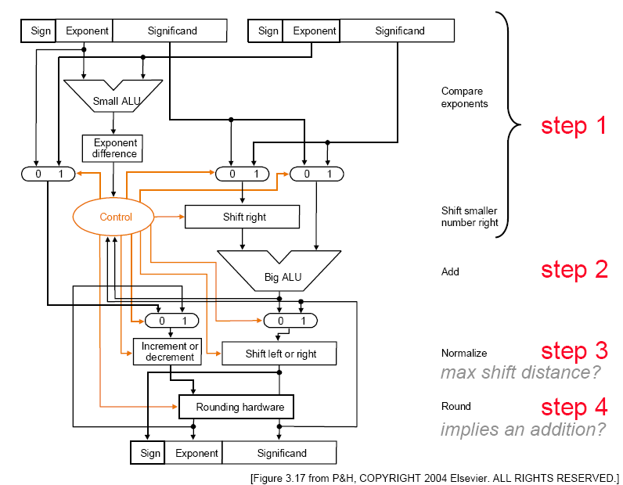
Floating-Point Addition

Slide 28
MIPS Floating Point
Floating point “Co-processor”
Separate co-processor for supporting floating-point
Separate circuitry for arithmetic, logic operations
Registers
F0…F31: each 32 bits
Good for single-precision (floats)
Or, pair them up: F0|F1 pair, F2|F3 pair … F30|F31 pair
Simply refer to them as F0, F2, F4, etc. Pairing implicit from instruction used
Good for 64-bit double-precision (doubles)

Slide 29
MIPS Floating Point
Instructions determine single/double precision
add.s $F2, $F4, $F6 // F2=F4+F6 single-precision add
add.d $F2, $F4, $F6 // F2=F4+F6 double-precision add
Really using F2|F3 pair, F4|F5 pair, F6|F7 pair
Instructions available:
add.d fd, fs, ft # fd = fs + ft in double precision
add.s fd, fs, ft # fd = fs + ft in single precision
sub.d, sub.s, mul.d, mul.s, div.d, div.s, abs.d, abs.s
l.d fd, address # load a double from address
l.s, s.d, s.s
Conversion instructions: cvt.w.s, cvt.s.d, …
Compare instructions: c.lt.s, c.lt.d, …
Branch (bc1t, bc1f): branch on comparison true/false

Slide 30
End of optional material

Slide 31
Next
Sequential circuits
Those with memory
Useful for registers, state machines
Let’s put it all together
… and build a CPU

